Slide 1

What are the requirements data to construct platoon truck ?
Truck Platooning System
Team members:
-Raed Kayali
-Mohamed Al-Salihi
-Ismail Elsayed
-Amr Abdrabo

Slide 2

What are the requirements data to construct platoon truck ?
Truck Platooning System
Signals

Slide 3


What are the requirements data to construct platoon truck ?
Signals
Data
Events

Slide 4
What are the requirements data to construct platoon truck ?
Signals
Data
Events

Slide 5
What are the requirements data to construct platoon truck ?
Signals
Data
Events

Slide 6
What are the requirements data to construct platoon truck ?
Signals
Events
Data

Slide 7
What are the requirements data to construct platoon truck ?
Signals
Events
Data

Slide 8



What are the requirements data to construct platoon truck ?
Signals
Events
Data
Stop
Movment
Ping
Events
Data

Slide 9
What are the requirements data to construct platoon truck ?
Signals
Events
Data

Slide 10




What are the requirements data to construct platoon truck ?
Events
Signals
Data
Steering Degree
Path
Location
Speed
Signals
Events

Slide 11
What are the requirements data to construct platoon truck ?
Signals
Events
Data

Slide 12


Data
Signals
Events
Decoupling
Coupling

Slide 13
Server
What are the requirements data to construct platoon truck ?
Signals
Events
Data

Slide 14
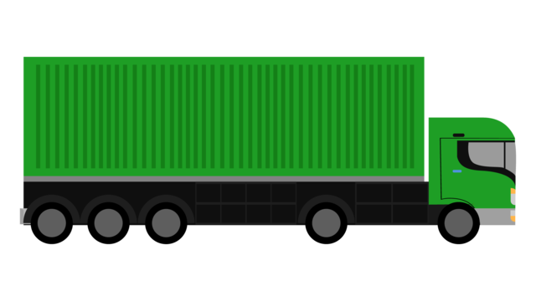
Master
What are the requirements data to construct platoon truck ?
Signals
Events
Data

Slide 15


Master Tasks
-Sending required data (Speed , acceleration ,steering , location) ​
-Sending signals like (emergency stop, brake)​
-Sending events & handling it ​
​
Master
Master
Slave
Web Socket

Slide 16

Master Communication
Master acts as the web socket server
Master
Master Tasks
-Sending required data (Speed , acceleration ,steering , location) ​
-Sending signals like (emergency stop, brake)​
-Sending events & handling it ​
​
Slave
Master
Web Socket

Slide 17
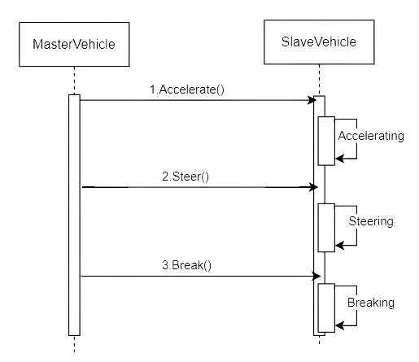
Master
Master Communication
Master acts as the web socket server
Slave
Master
Web Socket
Master Tasks
-Sending required data (Speed , acceleration ,steering , location) ​
-Sending signals like (emergency stop, brake)​
-Sending events & handling it ​
​

Slide 18
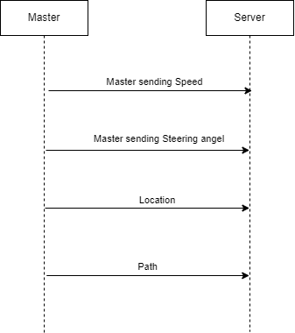
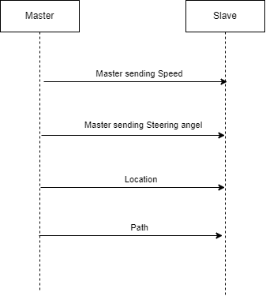

Master Signal​
Using Directed signal (antenna) to guarantee strong Wi-Fi signal to all slaves
Master
-Sending required data(Speed , acceleration ,steering , location) ​
-Sending signals like (emergency stop, brake)​
-Sending events & handling it ​
​
Web Socket
Slave
Master
Master

Slide 19

Master
Master Signal​
Using Directed signal (antenna) to guarantee strong Wi-Fi signal to all slaves
Master
Slave 2
Slave 1
Slave 3
Slave 2
Slave 1
Master
Slave 3
Slave 3
Master

Slide 20
Master
Master Decoupling Scenario​
If the slave is too distanced to receive the master signal than it is decoupled
Slave
Master
Slave 3
Slave 2
Slave 1
Master
Slave 3
Slave 3
Master

Slide 21
Master
Decoupling Scenario​
Slave 3
Slave 2
Slave 1
Master
Slave 3
Slave 2
Slave 1
Master
Slave 2
Slave 1
Show “Slave Lost” Signal
Master

Slide 22

Master
Recoupling Scenario​
Recoupled once the slave is pinged again
Slave 1
Server
Slave 3
Slave 2
Master
Thread 2
Slave 3
Slave 2
Slave 1
Master
Slave 3
Slave 3
Master

Slide 23
Master
Threading
Slave
Master
- One thread’s whole purpose is sending signal from the master to the slave with the upcoming signal for an action ( acceleration, deceleration, steering left, steering right. etc…)
Web Socket

Slide 24

Master
Threading
- One Thread is responsible only for sending the current location of the Master to the Server on repeat
Master
Server
Slave 1
Slave 2
Slave 3
Thread 2
Web Socket

Slide 25
- One thread’s whole purpose is sending signal from the master to the slave with the upcoming signal for an action ( acceleration, deceleration, steering left, steering right, etc…)
Master
Threading
- Other thread is responsible for sending actions data (ex: accelerate, steer, brake) to other slaves
Thread 1
Slave
Master
Server
Thread 1
Web Socket

Slide 26
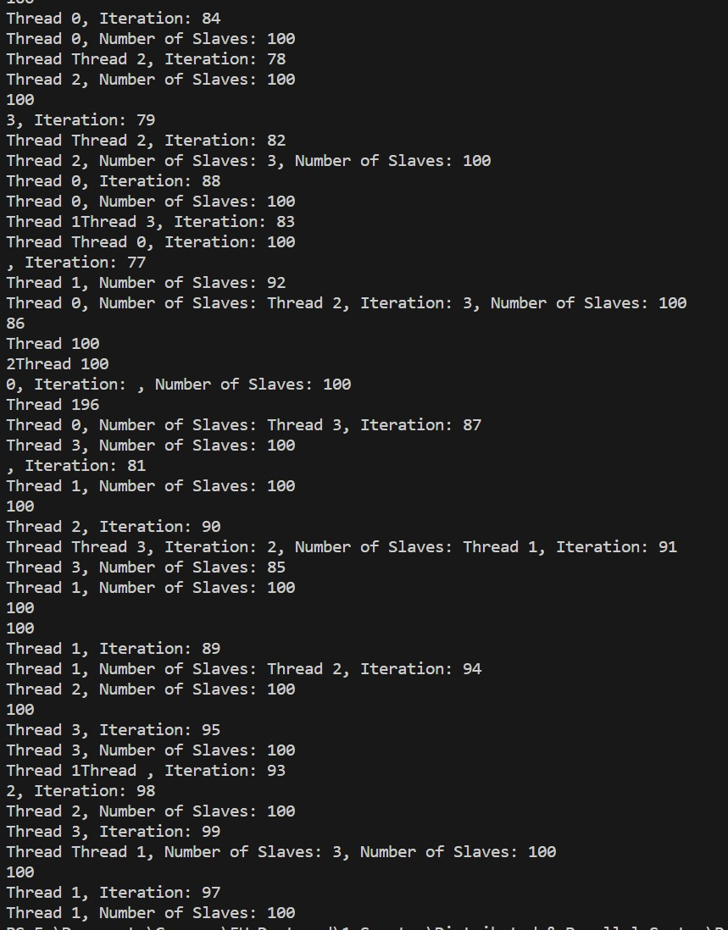
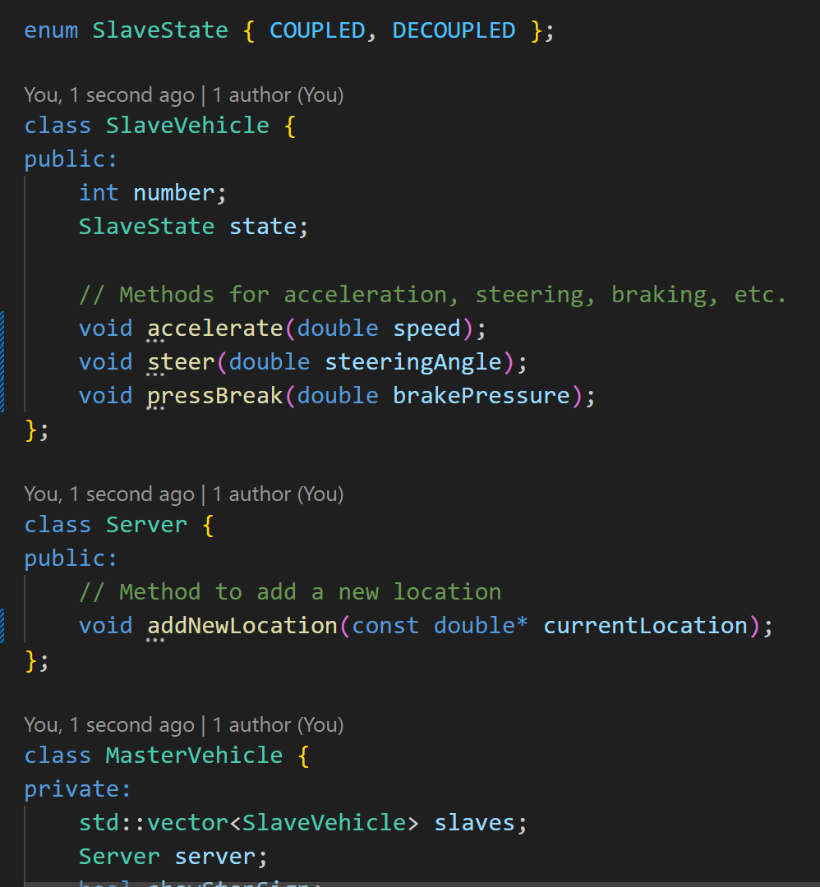
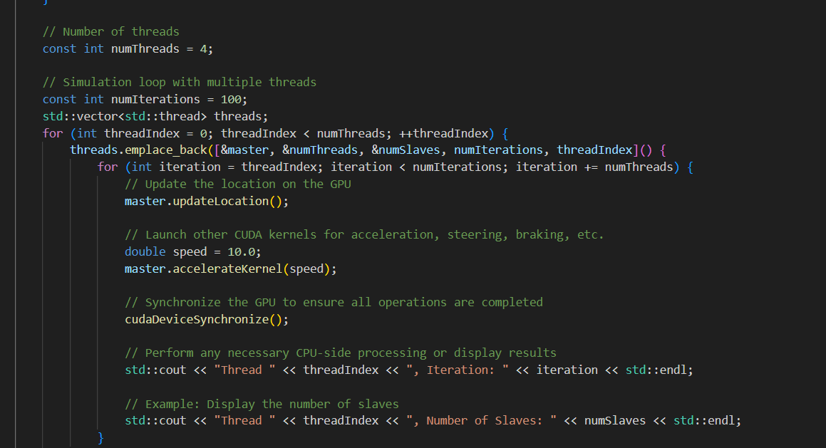
Master
Implementation
- A Thread is responsible only for sending the current location of the Master to the Server on repeat
Master
Server
Slave 1
Slave 2
Slave 3
Thread 2
The server & slaves' interfaces
The thread function for sending data to slaves
Web Socket

Slide 27
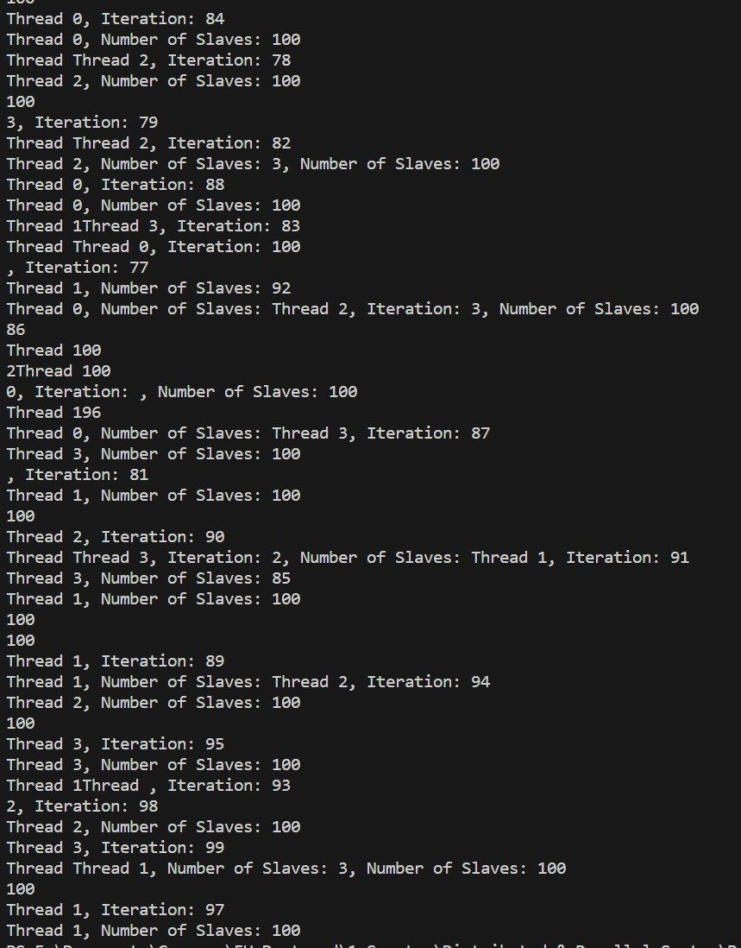
Master
Implementation
- A Thread is responsible only for sending the current location of the Master to the Server on repeat
Result
Server
Slave 1
Slave 2
Slave 3
Thread 2
The server & slaves' interfaces
The thread function for sending data to slaves
Master
Web Socket

Slide 28
Master
Implementation
- A Thread is responsible only for sending the current location of the Master to the Server on repeat
Result
Server
Slave 1
Slave 2
Slave 3
Thread 2
Master
Web Socket
The server & slaves' interfaces
The thread function for sending data to slaves

Slide 29
Slave
Slave
Master
Web Socket
Result

Slide 30
Sequence Diagram
- The Slave is connected to master Via Web Socket
- The connection is done through Wi-Fi signal
- The Slave follow the instructions given by the Master
Slave
Slave
Master
Web Socket

Slide 31
Sequence Diagram
Slave
- The Slave is connected to master Via Web Socket
- The connection is done through Wi-Fi signal
- The Slave follow the instructions given by the Master
Slave
Master
Web Socket

Slide 32







Slave
when the distance is increased, the Web Socket connection is lost, and the instructions are then sent by the server
Scheiße!
Slave
Master

Slide 33
Slave
- In Case of a Pedestrian passing in front of the Slave
- The Slave breaks
Slave
Scheiße!
Master

Slide 34


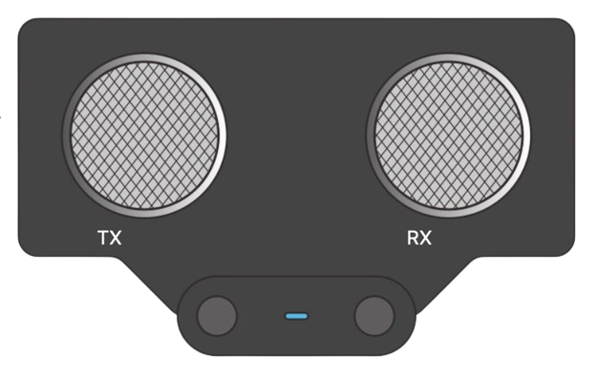
Slave
Slave
Scheiße!
- Due to Ultrasonic sensor, the system ensures a minimum distance between Truck and
objects Infront
Master

Slide 35
- Due to breaking, the distance between the slave and the master increased and the connection was lost
-The slave now is connected to the server
Slave
Scheiße!
Slave
Master

Slide 36
Some characteristics of the Auto Drive mode:
Maximum speed of 50km/h
Minimum distance with ahead object of 15 meters
Slave
Scheiße!
Slave
Master

Slide 37
Slave
Threading
Slave
Master
- One thread’s whole purpose is sending signal from the master to the slave with the upcoming signal for an action ( acceleration, deceleration, steering left, steering right. etc…)
Web Socket

Slide 38
Slave
Threading
- One thread’s whole purpose is sending signal from the master to the slave with the upcoming signal for an action ( acceleration, deceleration, steering left, steering right. etc…)
Thread 1
Slave 1
Thread 2
Server
Slave 2
Thread 3
Server
Slave 3
Server

Slide 39
- One thread’s whole purpose is sending signal from the master to the slave with the upcoming signal for an action ( acceleration, deceleration, steering left, steering right, etc…)
Slave
Threading
- One thread’s whole purpose is sending signal from the master to the slave with the upcoming signal for an action ( acceleration, deceleration, steering left, steering right. etc…)
Thread 1
Slave
Master
Server
Thread 1
Web Socket

Slide 40
Slave
Threading
- Another Threading is done between each Slave and Master that takes the Master’s current position and sends it to that particular Slave
- There is a separate Thread for each Slave doing the operation
Slave 1
Server
Thread 1
Sequence Diagram
Slave 2
Server
Thread 2
Master
Slave 3
Server
Thread 3
Server
Slave

Slide 41
Slave
- The Slave is connected to Slave Via HTTP Protocol to the server
- The Slave requests the Location of the master
- The Server then sends a GPS location to the slave with the current location of the master
- The Slave then uses Auto-Pilot to drive the master
Server
Sequence Diagram
Slave
Master

Slide 42
Slave
- The Slave is connected to master once in range and the coupling process is back on
Slave
Master

Slide 43
Slave
- The Slave is connected to master once in range and the coupling process is back on
Slave
Master
Sequence Diagram
Master

Slide 44
Server
Slave
Web Socket

Slide 45
Server
Connection Between Devices
The “Server” is a normal HTTP Server
It’ll be used for handling fault and emergencies along the trip, Also for saving a history of all the trips of the system
Server
HTTP Connection
HTTP Connection
Master Vehicle
Slave Vehicle
Web Socket
Slave Vehicle
Slave Vehicle
Slave
Web Socket

Slide 46
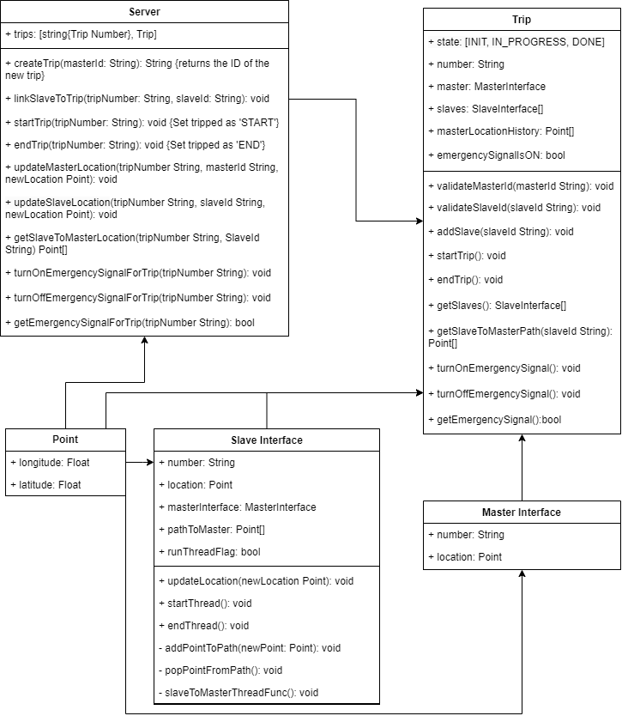
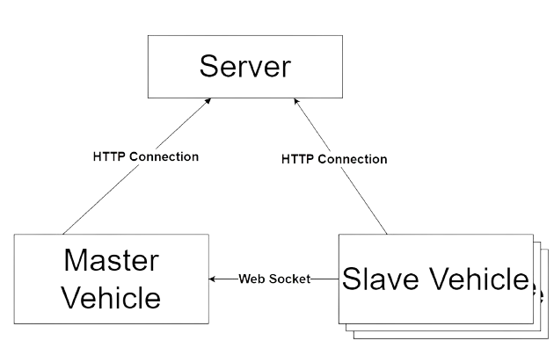

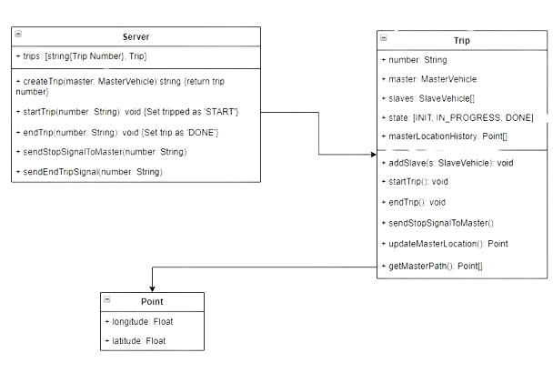
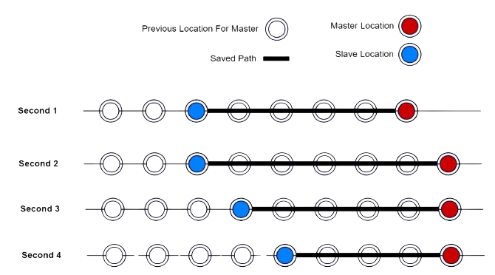
Server Design​
Server create “Trip” object for each trip in real life
Each trip has one master and 0 to many slaves
Both master and slave are expected to send their location to the server on a fixed time
Server
Server Tasks​
Receiving & saving the location of the master and the slaves
Send the path to the master when the slave request it for Auto drive
Let other vehicles know in case of emergency
Method​ | Endpoint​ | Request Body​ | Response Body​
POST​ | /master/create/​ | NULL​ | "NEW_MASTER_ID"​
POST​ | /slave/create​ | NULL​ | "NEW_SLAVE_ID"​
POST​ | /trip/create​ | {"masterId": "NEW_MASTER_ID"}​ | "NEW_TRIP_ID"​
POST​ | /trip/{TRIP_ID}/link-slave/​ | {"slaveId": "NEW_SLAVE_ID"}​ | NULL​
POST​ | /trip/{TRIP_ID}/start/​ | NULL​ | NULL​
POST​ | /trip/{TRIP_ID}/end/​ | NULL​ | NULL​
POST​ | /trip/{TRIP_ID}/update-location/​ | {"vehicleId": "SLAVE_ID", "longitude": 11.11, "latituded": 22.22}​ | NULL​
GET​ | /trip/{TRIP_ID}/get-master-path/​ | NULL​ | Point []​
POST​ | /trip/{TRIP_ID}/send-emergency/​ | NULL​ | ​
GET​ | /trip/{TRIP_ID}/get-emergency-state/​ | NULL​ | Boolean​
Slave
Web Socket

Slide 47
How saving the SlaveToMasterPath works​
Every slave runs in its own thread to update the path to the master
Server
Server Design​
Server create “Trip” object for each trip in real life
Each trip has one master and 0 to many slaves
Both master and slave are expected to send their location to the server on a fixed time
Previous Location For Master
Master Location
Server Tasks​
Saved Path
Slave Location
Slave
Receiving & saving the location of the master and the slaves
Send the path to the master when the slave request it for Auto drive
Let other vehicles know in case of emergency
Second 1
Second 2
Second 3
Web Socket
Second 4

Slide 48
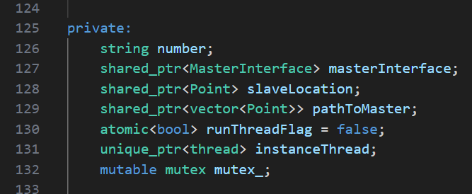
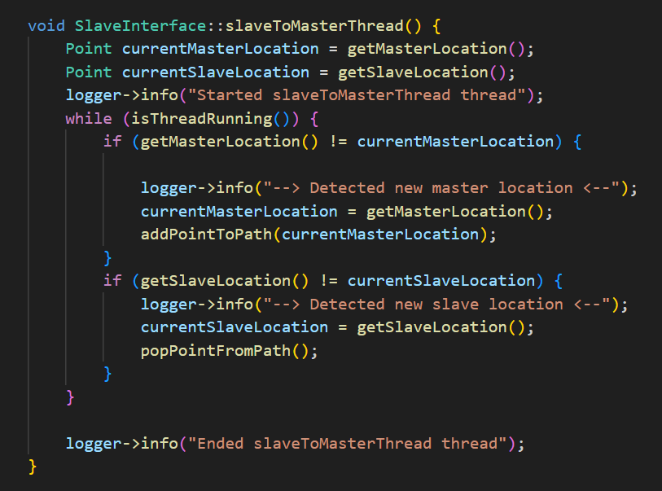
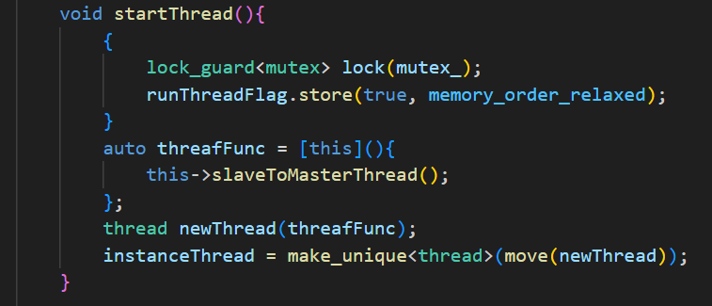
Server
The attributes for the slave interface
How saving the SlaveToMasterPath works​
Every slave runs in its own thread to update the path to the master
Server Design​
Previous Location For Master
Master Location
Saved Path
Slave Location
Second 1
Second 2
Second 3
Second 4
The function to start the thread
The slaveToMaster thread function
Slave
Web Socket
Server create “Trip” object for each trip in real life
Each trip has one master and 0 to many slaves
Both master and slave are expected to send their location to the server on a fixed time

Slide 49
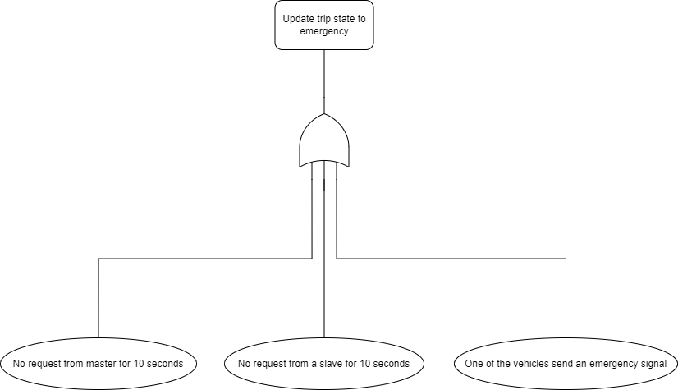
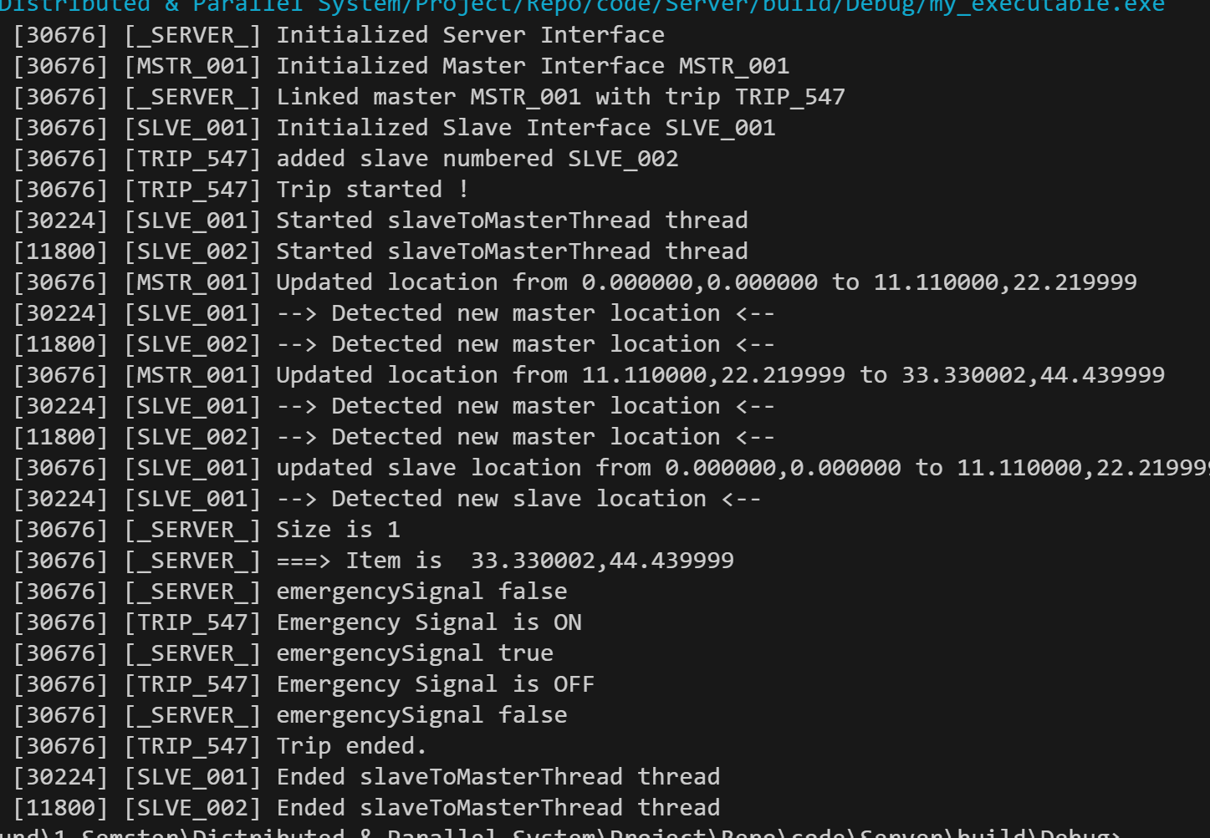
Emergency State Fault Tree​
Server
Thread number
Updating master location
Update slave location
Handling Emergency signal
Server Design​
The attributes for the slave interface
The slaveToMaster thread function
The function to start the thread
Previous Location For Master
Master Location
Saved Path
Slave Location
Second 1
Slave
Second 2
Second 3
Second 4
Web Socket

Slide 50
Emergency State Fault Tree​
The attributes for the slave interface
Server
Thread number
Updating master location
Update slave location
Handling Emergency signal
Server Design​
The slaveToMaster thread function
Previous Location For Master
Master Location
Saved Path
Slave Location
Second 1
Slave
Second 2
Second 3
Second 4
Web Socket
The function to start the thread

Slide 51
Server Endpoint​
Method​ | Endpoint​ | Request Body​ | Response Body​
POST​ | /master/create/​ | NULL​ | "NEW_MASTER_ID"​
POST​ | /slave/create​ | NULL​ | "NEW_SLAVE_ID"​
POST​ | /trip/create​ | {"masterId": "NEW_MASTER_ID"}​ | "NEW_TRIP_ID"​
POST​ | /trip/{TRIP_ID}/link-slave/​ | {"slaveId": "NEW_SLAVE_ID"}​ | NULL​
POST​ | /trip/{TRIP_ID}/start/​ | NULL​ | NULL​
POST​ | /trip/{TRIP_ID}/end/​ | NULL​ | NULL​
POST​ | /trip/{TRIP_ID}/update-location/​ | {"vehicleId": "SLAVE_ID", "longitude": 11.11, "latituded": 22.22}​ | NULL​
GET​ | /trip/{TRIP_ID}/get-master-path/​ | NULL​ | Point []​
POST​ | /trip/{TRIP_ID}/send-emergency/​ | NULL​ | ​
GET​ | /trip/{TRIP_ID}/get-emergency-state/​ | NULL​ | Boolean​
Server
Emergency State Fault Tree​
Receiving & saving the location of the master and the slaves
Send the path to the master when the slave request it for Auto drive
Let other vehicles know in case of emergency
Slave
Thread number
Updating master location
Update slave location
Handling Emergency signal
Web Socket

Slide 52
Server
Server Endpoint​
Method​ | Endpoint​ | Request Body​ | Response Body​
POST​ | /master/create/​ | NULL​ | "NEW_MASTER_ID"​
POST​ | /slave/create​ | NULL​ | "NEW_SLAVE_ID"​
POST​ | /trip/create​ | {"masterId": "NEW_MASTER_ID"}​ | "NEW_TRIP_ID"​
POST​ | /trip/{TRIP_ID}/link-slave/​ | {"slaveId": "NEW_SLAVE_ID"}​ | NULL​
POST​ | /trip/{TRIP_ID}/start/​ | NULL​ | NULL​
POST​ | /trip/{TRIP_ID}/end/​ | NULL​ | NULL​
POST​ | /trip/{TRIP_ID}/update-location/​ | {"vehicleId": "SLAVE_ID", "longitude": 11.11, "latituded": 22.22}​ | NULL​
GET​ | /trip/{TRIP_ID}/get-master-path/​ | NULL​ | Point []​
POST​ | /trip/{TRIP_ID}/send-emergency/​ | NULL​ | ​
GET​ | /trip/{TRIP_ID}/get-emergency-state/​ | NULL​ | Boolean​
Receiving & saving the location of the master and the slaves
Send the path to the master when the slave request it for Auto drive
Let other vehicles know in case of emergency
Slave
Emergency State Fault Tree​
Web Socket

Slide 53

Code
Sequence Diagram
Slave
Master

Slide 54

Code
Sequence Diagram
Slave
Master

Slide 55

Code
Sequence Diagram
Slave
Master

Slide 56

Code
Sequence Diagram
Slave
Master

Slide 57
Thank You ☺
Any questions ?
Sequence Diagram
Slave
Master

Slide 58
Thank You ☺
Sequence Diagram
Slave
Master
Any questions ?

